Slide 1
MES WORKFLOW

Slide 2
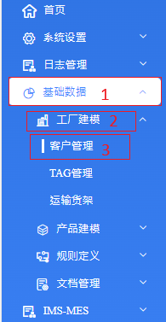
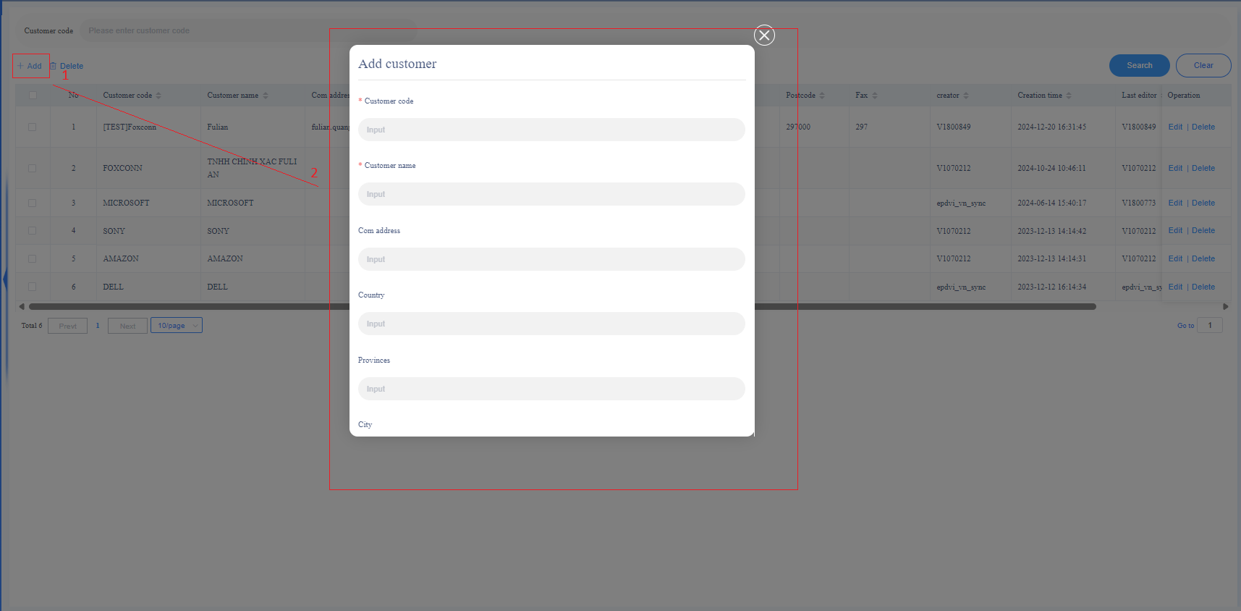
Add customer /ims/basic/factory/customer
Step 1: Click in the following order
基础数据 → 工厂建模 → 客户管理.
Step 2: Click + Add → Fill in the customer information in the table.
*Note: Customer code is unique

Slide 3
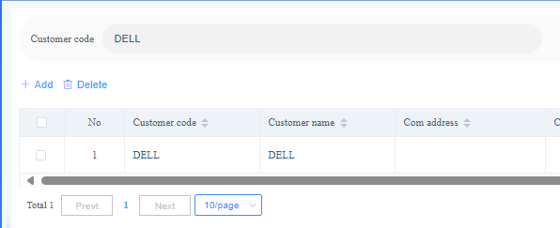
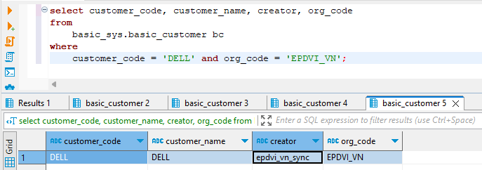
Add customer /ims/basic/factory/customer
After a successful addition, the data will be displayed on the system interface and then inserted into basic_sys.basic_customer

Slide 4
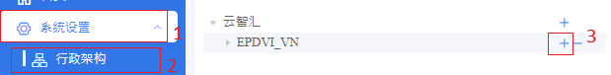
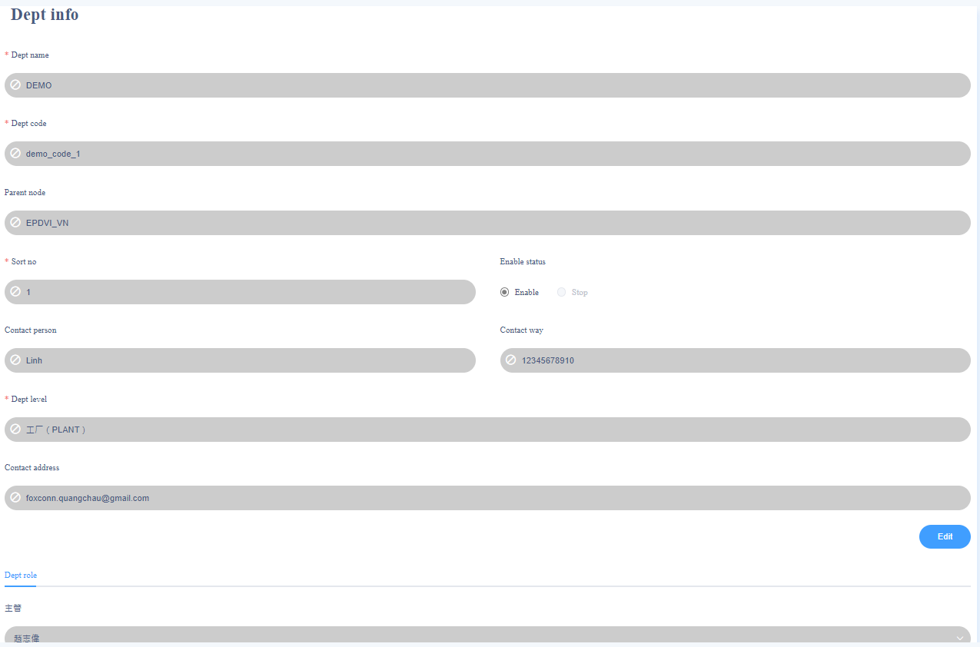
Add department /ims/system/org
Step 1: Click in the following order
行政架构(1) → 行政架构(2) → +(3)
Step 2: Fill in the department information in the table.
Dept type:部门类型-数据字典：1-事业处（bu） 2-工厂(plant) 3-部门(dept) 4-課()
*Note: Dept code is unique

Slide 5
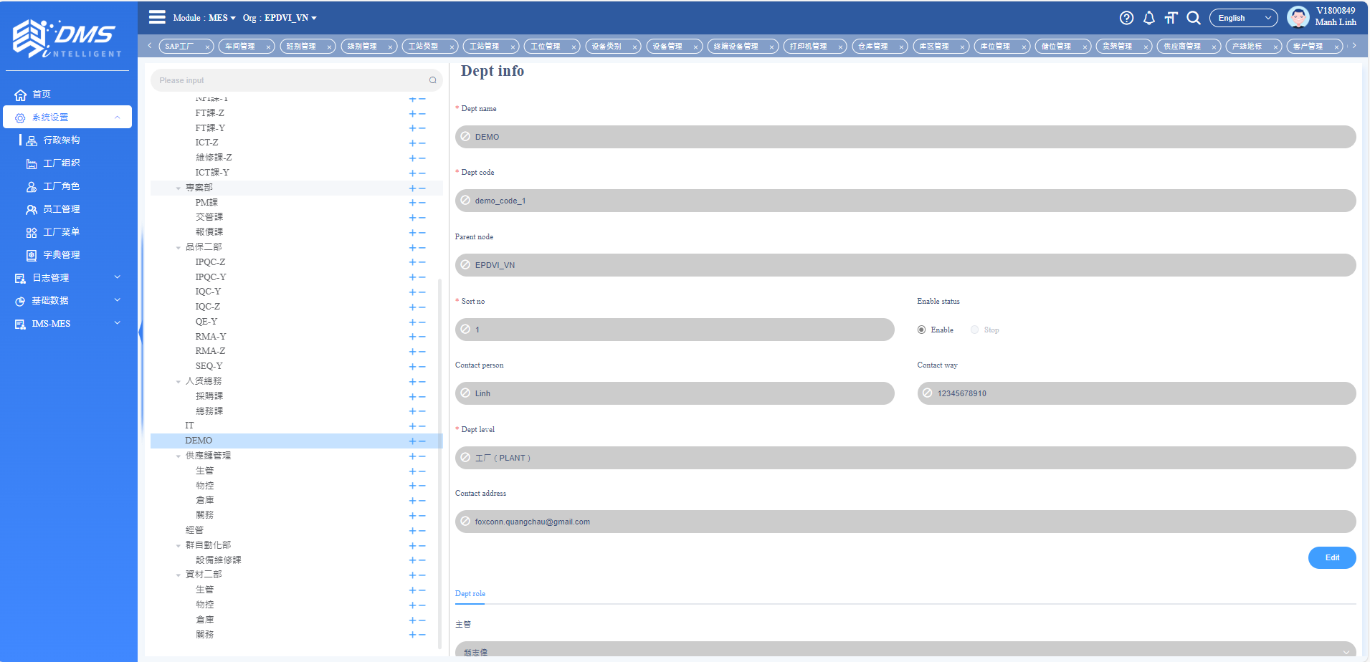
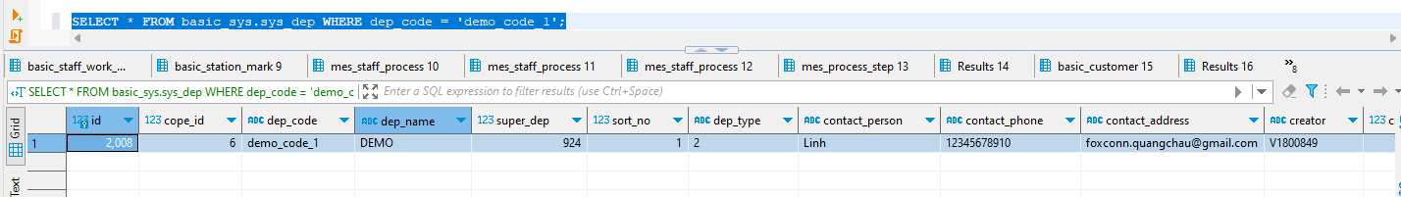
Add department /ims/system/org
After a successful addition, the data will be displayed on the system interface and then inserted into basic_sys.sys_dep

Slide 6
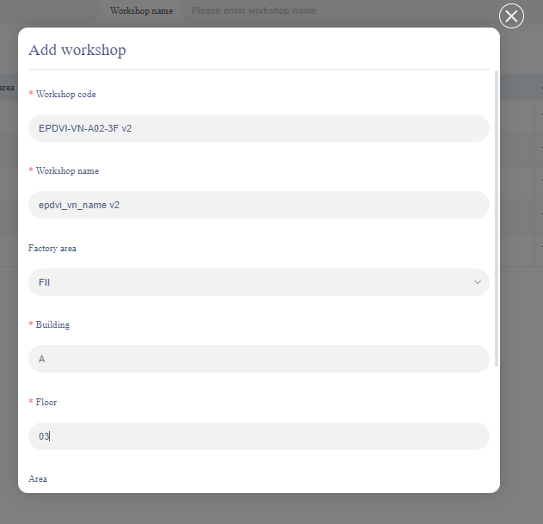
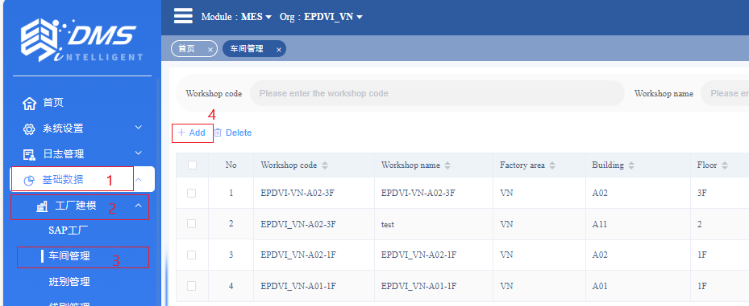
Add workshop /ims/basic/factory/workshop
Step 1: Click in the following order
基础数据 → 工厂建模 → 车间管理 → + Add.
Step 2: Fill in the workshop information in the table.
*Note: Workshop code is unique

Slide 7
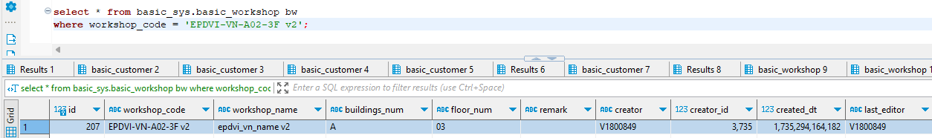
Add workshop /ims/basic/factory/workshop
After a successful addition, the data will be displayed on the system interface and then inserted into basic_sys.basic_workshop

Slide 8
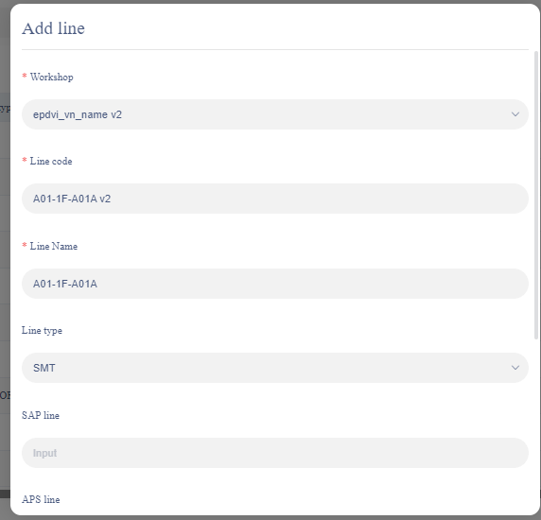
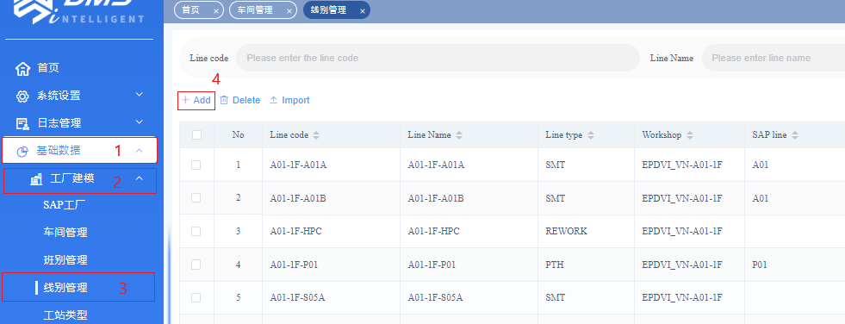
Add line /ims/basic/factory/line
Step 1: Click in the following order
基础数据 → 工厂建模 → 线别管理 → + Add.
Step 2: Fill in the line information in the table.
*Note:
+ Workshop is defined from the previous step.
+ Line code is unique

Slide 9
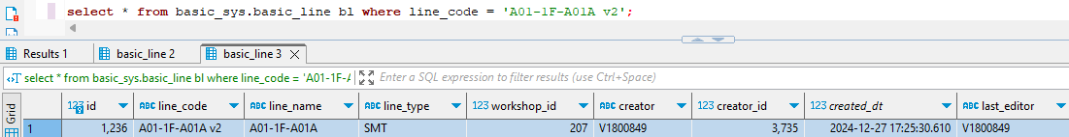
Add line /ims/basic/factory/line
After a successful addition, the data will be displayed on the system interface and then inserted into basic_sys.basic_line

Slide 10
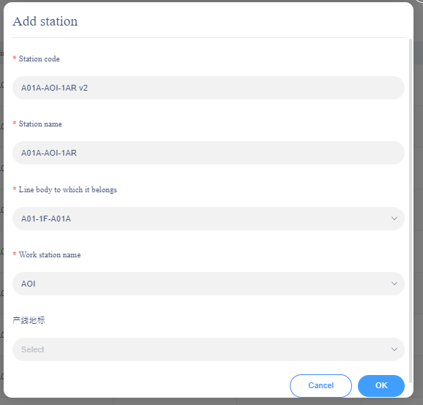
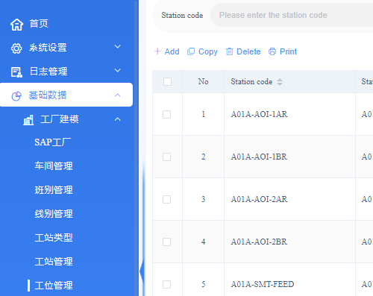
Add station /ims/basic/factory/station
Step 1: Click in the following order
基础数据 → 工厂建模 → 工位管理 → + Add.
Step 2: Fill in the line information in the table.
*Note: Station code is unique

Slide 11
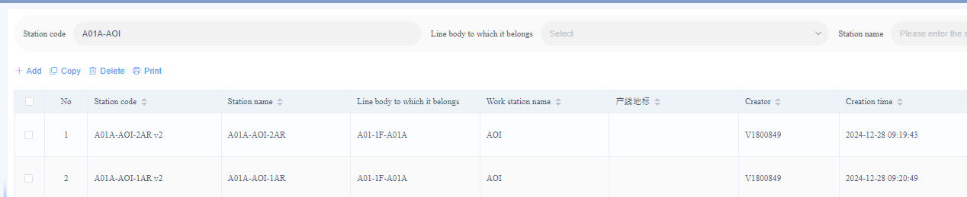
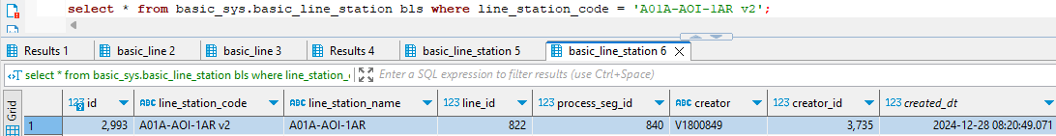
Add station /ims/basic/factory/station
After a successful addition, the data will be displayed on the system interface and then inserted into basic_sys.basic_line_station

Slide 12
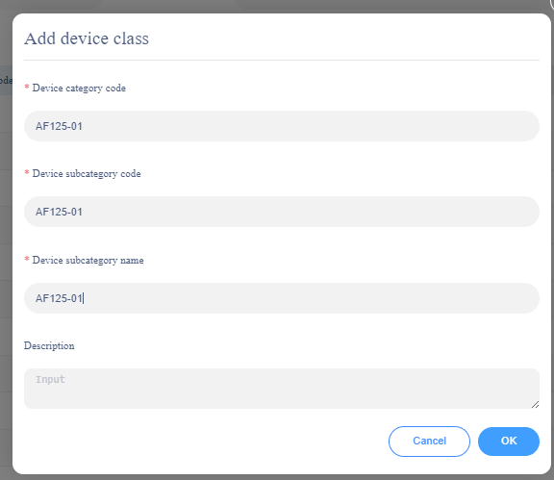
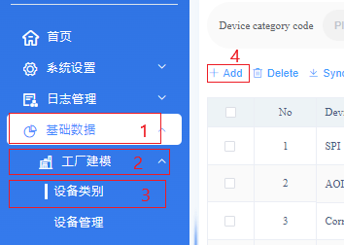
Add device category /ims/basic/factory/equipment-category
Step 1: Click in the following order
基础数据(1) → 工厂建模(2) → 设备类别(3) → + Add.
Step 2: Fill in the line information in the table.
*Note:
+ Device category data can be added by the user or synchronized based on the Device Subcategory Code.

Slide 13
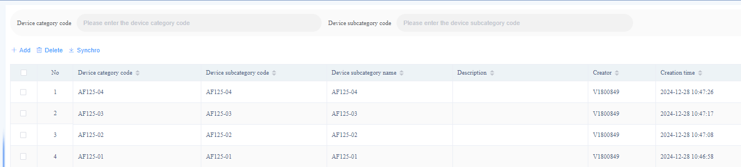
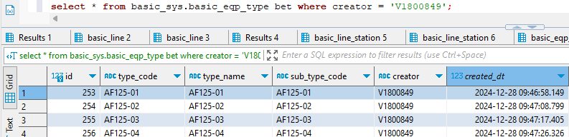
Add device category /ims/basic/factory/equipment-category
After a successful addition, the data will be displayed on the system interface and then inserted into basic_sys.basic_eqp_type

Slide 14
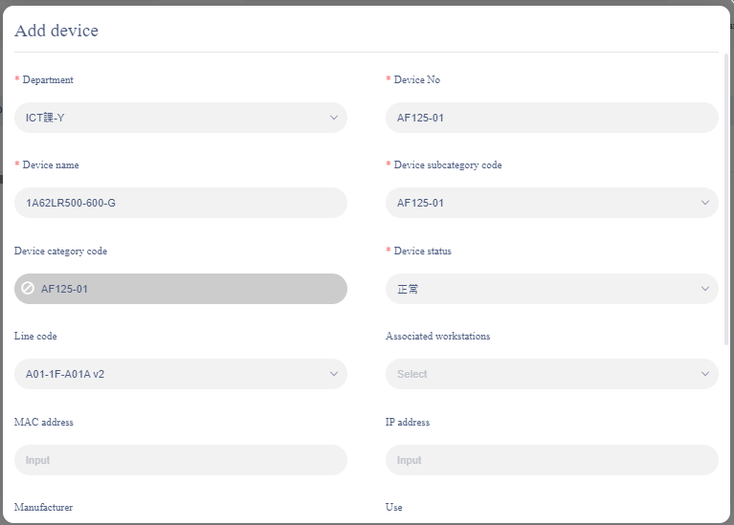
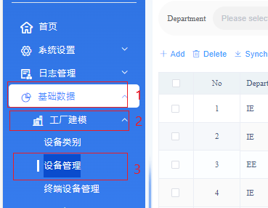
Add device /ims/basic/factory/equipment
Step 1: Click in the following order
基础数据(1) → 工厂建模(2) → 设备类别(3) → + Add.
Step 2: Fill in the line information in the table.
*Note:
+ Select associate workstation with the SMT feeding stations; otherwise, feeding will not be possible.
+ Device No is unique

Slide 15
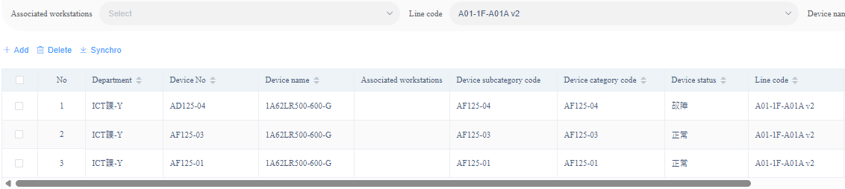
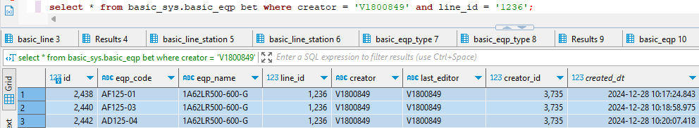
Add device /ims/basic/factory/equipment
After a successful addition, the data will be displayed on the system interface and then inserted into basic_sys.basic_eqp

Slide 16
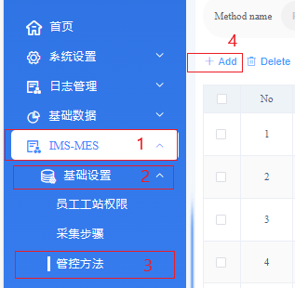
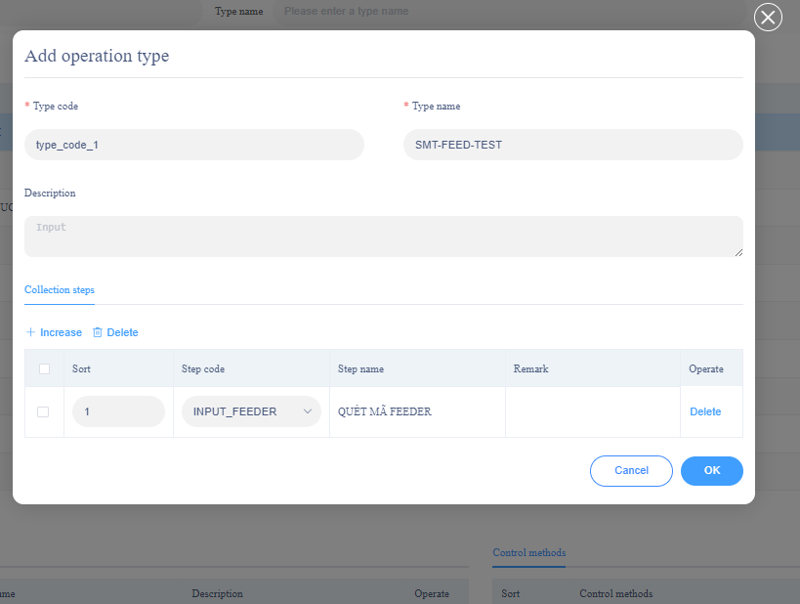
Add operation type /ims/mes/basic/control
Step 1: Click in the following order
IMS-MES (1) → 基础设置 (2) → 管控方法 (3) → + Add.
Step 2: Fill in the line information in the table.
Step 3: Click Increase to add operation type
*Note: Type code is unique

Slide 17
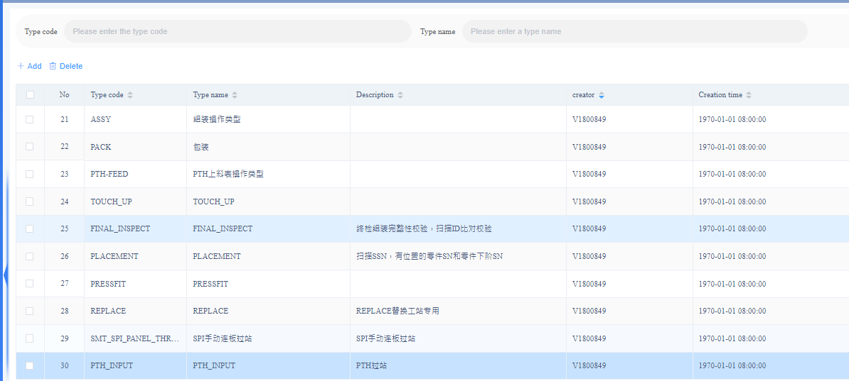
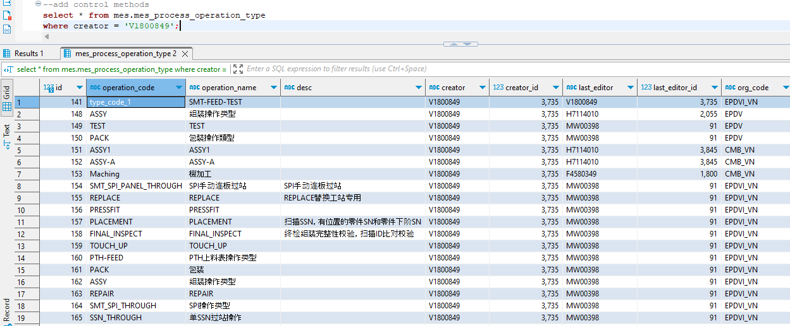
Add operation type /ims/mes/basic/control
After a successful addition, the data will be displayed on the system interface and then inserted into mes.mes_process_operation_type

Slide 18
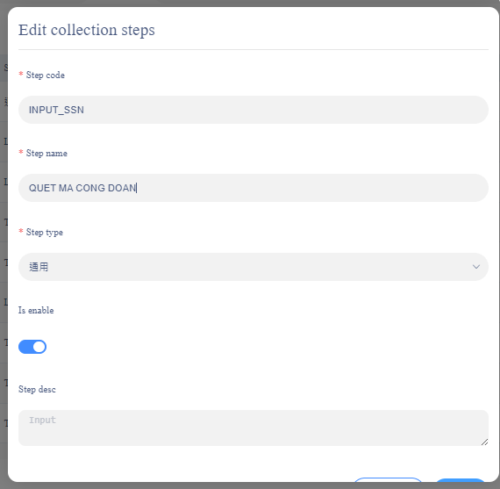
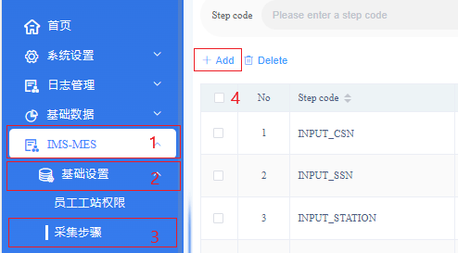
Config collection steps /ims/mes/basic/collection-step
Step 1: Click in the following order
IMS-MES → 基础设置 → 采集步骤 → + Add.
Step 2: Fill in the line information in the table.
*Note: Step code is unique

Slide 19
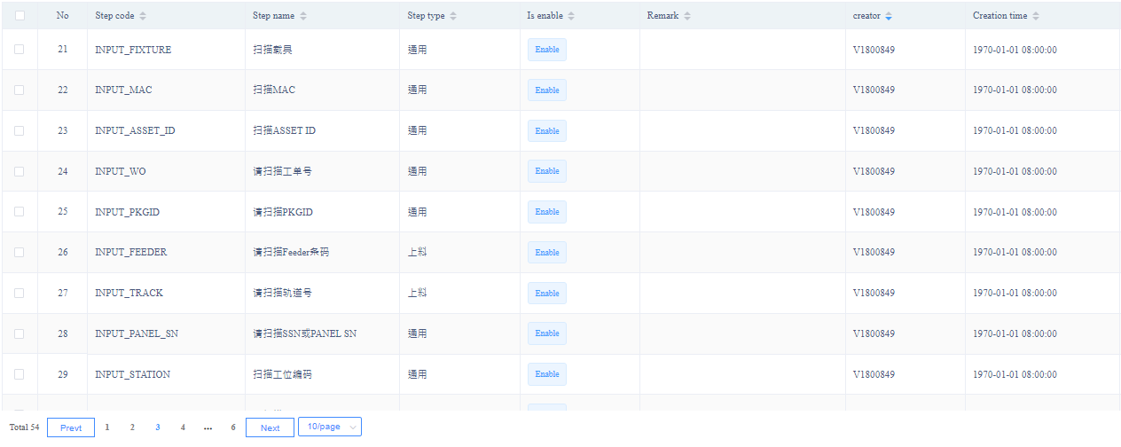
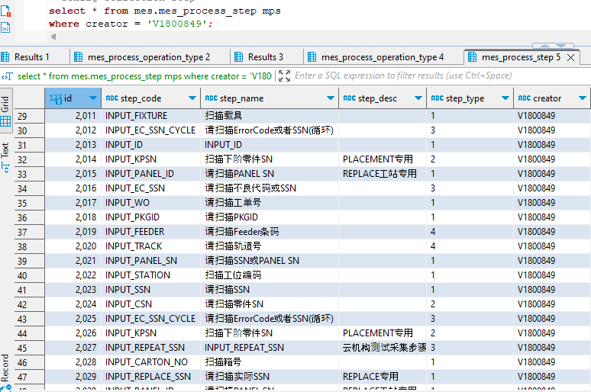
Config collection steps /ims/mes/basic/collection-step
After a successful addition, the data will be displayed on the system interface and then inserted into mes.mes_process_step

Slide 20
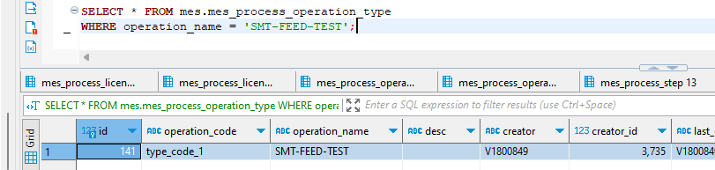
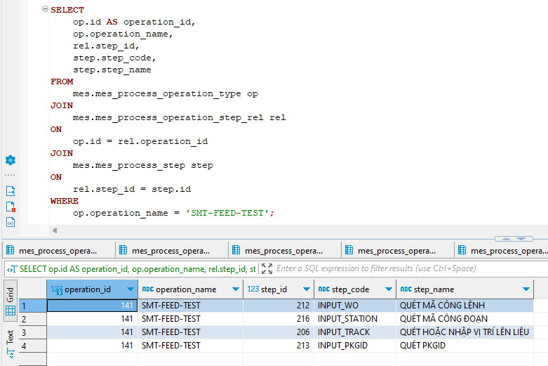
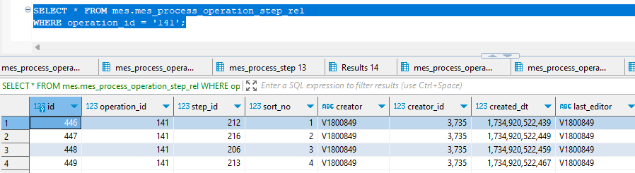
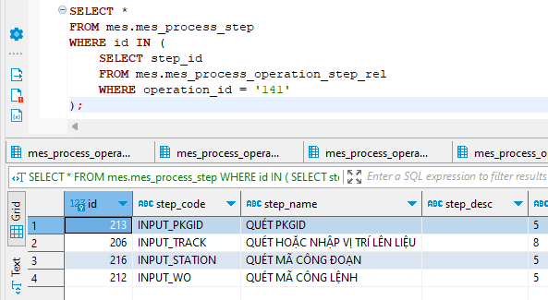
Process operation type
Notes:
Following the arrow in the slide, we can see the relationship between mes_process_step and mes_process_operation_type through mes_process_operation_step_rel.
Here I have an additional query to join the tables together to clearly show the information of the steps.

Slide 21
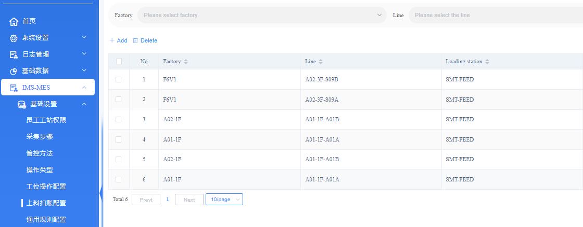
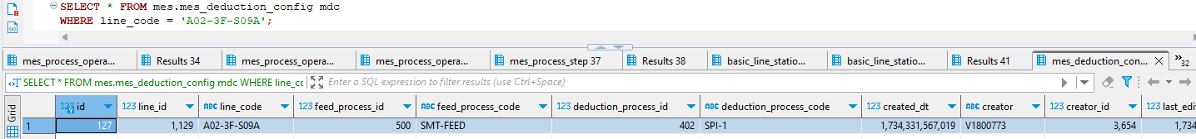
Configure SMT deduction /ims/mes/basic/station-deduct
Step 1: Click in the following order
IMS-MES → 基础设置 → 上料扣账配置 → + Add.
(/ims/mes/basic/station-deduct)
Step 2: Fill in the line information in the table.
After a successful addition, the data will be displayed on the system interface and then inserted into mes.mes_deduction_config

Slide 22
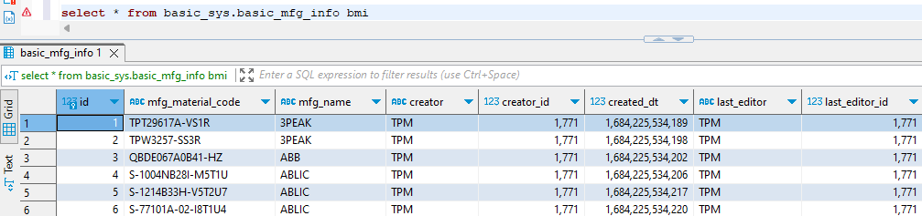
MSG master information
SELECT * FROM basic_sys.basic_mfg_info bmi;

Slide 23
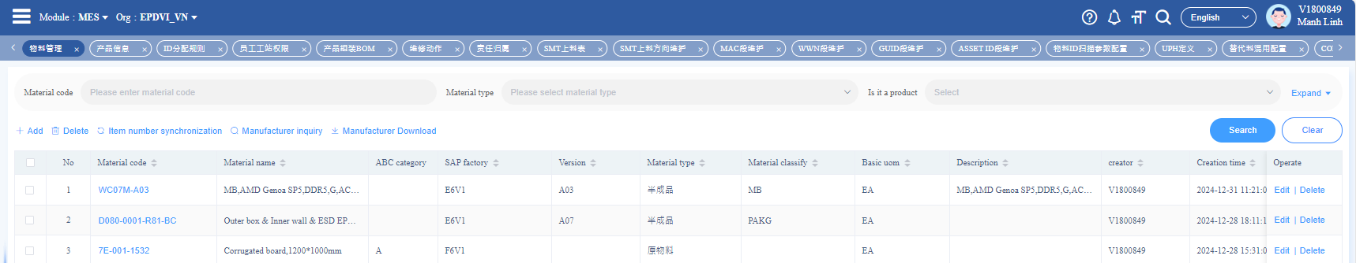
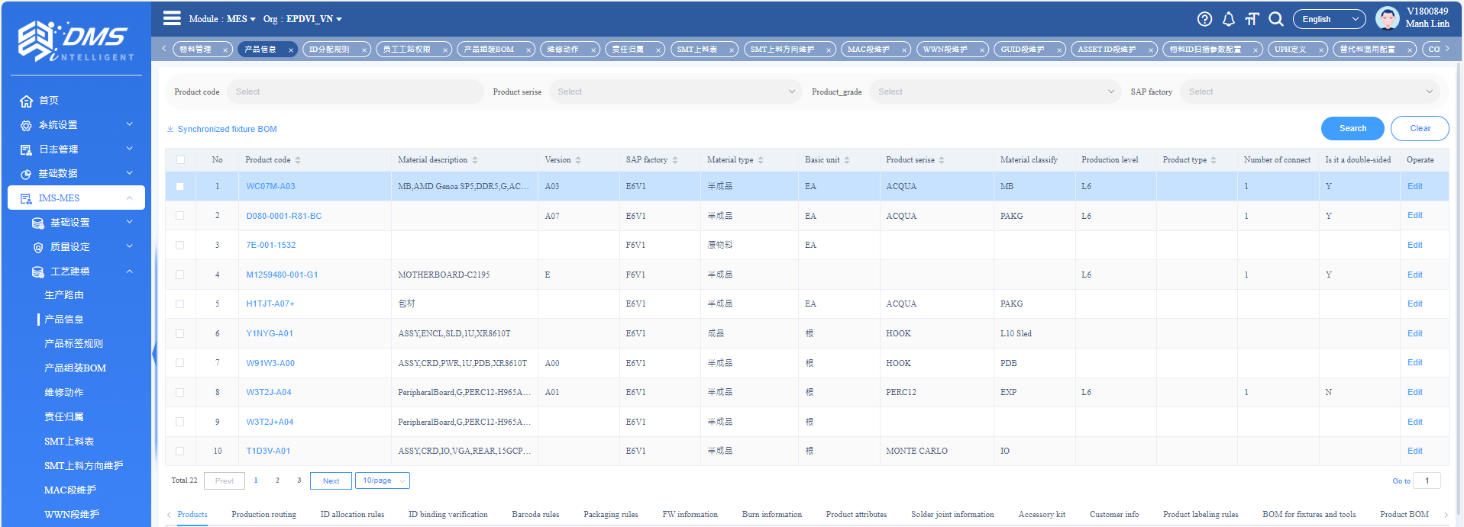
Add a new product (new material code)
The product code and material code are automatically synchronized. - You can add a new material code on screen (1) (/ims/basic/product/material) / 物料管理. - The data on screen (2) (/ims/mes/process/product) is automatically synchronized / 产品信息.
1
2

Slide 24
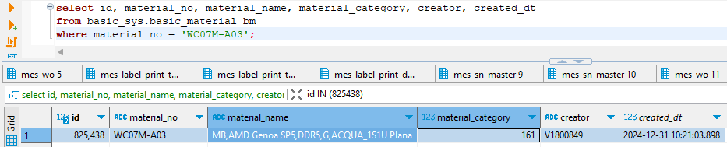
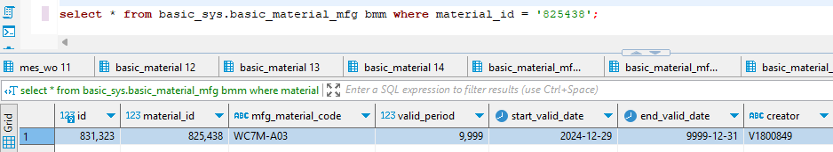
Add a new product (new material code)/ Table mapping MFG infomation
Bảng lưu trữ thông tin nhà mfg mapping với mã liệu

Slide 25
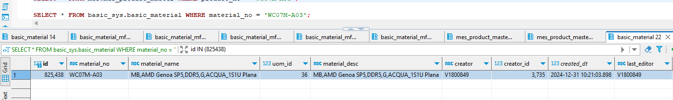
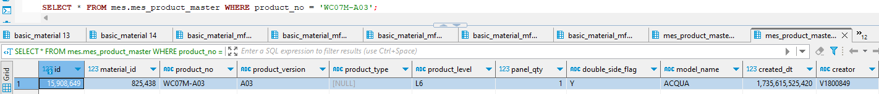
Add a new product (new material code)/ Database
IMS-MES / 工艺建模 / 产品信息
Data is synchronized from SAP.
Add new data to the table.
Key mapping mes.mes_product_master.material_id → basic_sys.basic_material.id

Slide 26
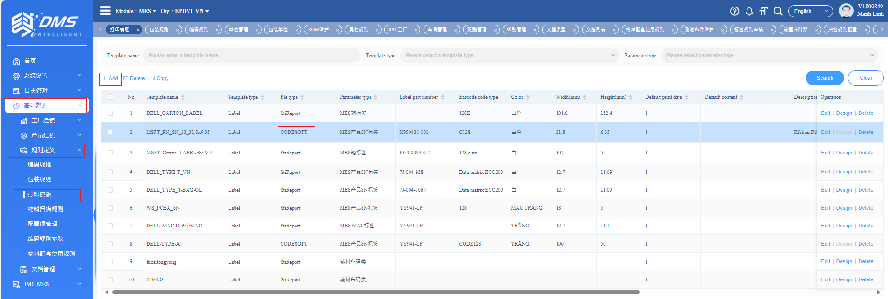
Add print-template /ims/basic/rule/print-template
Step 1: Click in the following order
基础数据 → 规则定义 → 打印模版 → + Add.
Step 2: Fill in the line information in the table.
CODESOFT: Print labels from other supporting software.
StiReport: Print labels directly from the MES system on the screen 标签列印任务 / Label Print Task.

Slide 27
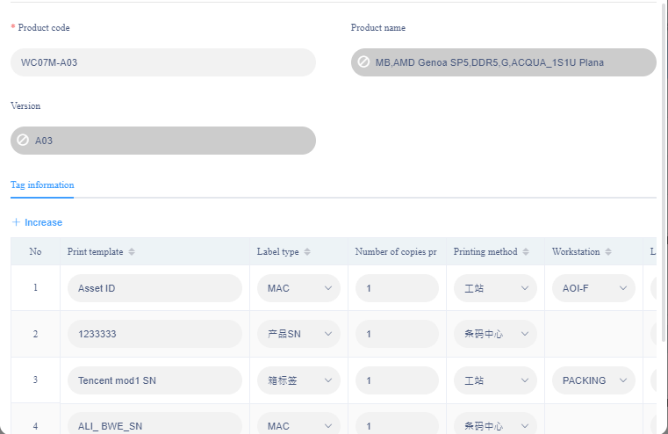
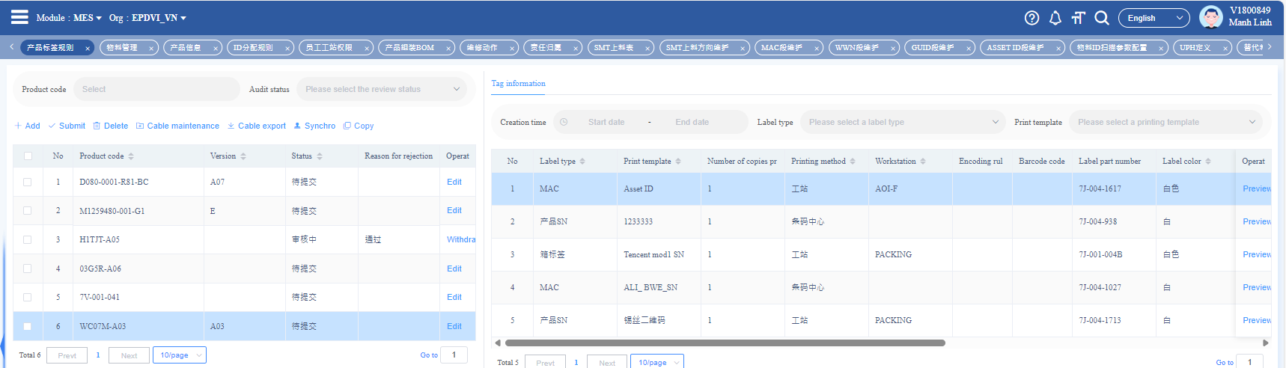
Add product labeling rules /ims/mes/process/label-rule
Step 1: Click in the following order
IMS-MES → 工艺建模 → 产品标签规则 → + Add.
Step 2: Fill in the line information in the table.

Slide 28


Add product labeling rules /ims/mes/process/label-rule
After a successful addition, the data will be inserted into the mes.mes_deduction_config
- Key mapping
mes.mes_label_rule_master.id
mes.mes_label_rule_config.label_rule_id

Slide 29


Generate SN for order management /ims/mes/plan/wo
Tick the work order and select Barcode → Barcode Generation. The SN range will be generated based on the work order quantity and displayed in the Barcode Details section.

Slide 30

Generate SN for order management /ims/mes/plan/wo
Click in the following order
IMS-MES → 条码管理 → 标签列印任务 to check the SN range and print labels.

Slide 31



Generate SN for order management /ims/mes/plan/wo
*Note print flag:
Not print: [], Printed [v]

Slide 32


SMT Material List /ims/mes/process/smt-bom
Step 1: Click in the following order
IMS-MES → 工艺建模 → SMT上料表 → + Add.
Step 2: Fill in the line information in the table.

Slide 33


SMT Material List /ims/mes/process/smt-bom

Slide 34

ASSY BOM /ims/mes/process/assy-bom

Slide 35


ASSY BOM /ims/mes/process/assy-bom

Slide 36


Workflow /ims/mes/process/route
(1) Basic Information about the Workflow
(2) List of products using the workflow
(3) Details of the stations in the workflow

Slide 37


Workflow /ims/mes/process/route
Data of worlflow information table
Products currently running the workflow are linked through route_id.

Slide 38


Workflow /ims/mes/process/route
Table:
- mes.mes_route: Stores basic information of the workflow. - mes.mes_route_node: Stores the nodes within the workflow. => These two tables are linked by route_id.
- mes.mes_route_conn: Stores the paths between nodes in the workflow. => It is linked to the other two tables by route_id, node_source_id, and node_target_id. + condition: The condition to move to the next node (PASS/FAIL). + process_from_id / process_to_id: These values are retrieved from the basic_sys.basic_process_seg table based on the selected node name in the interface.

Slide 39


ORDER MANAGEMENT ONLINE /ims/mes/plan/wo

Slide 40

SMT MATERIAL

